Slide 1
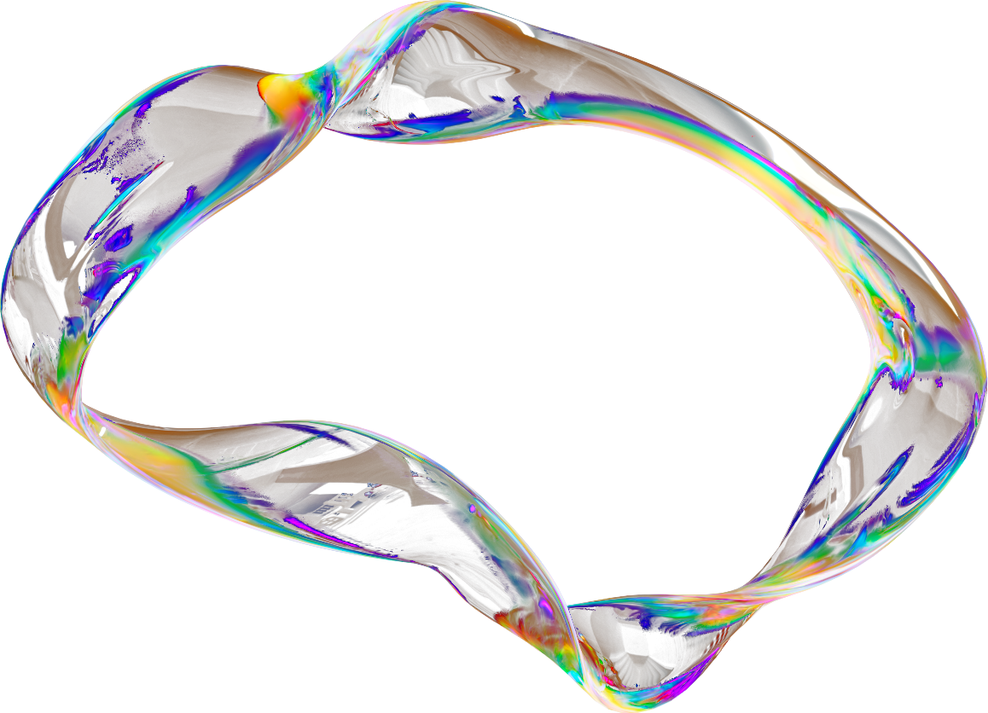

SMART DOOR LOCK
Present by I Tahir Khan & Shaik Wasim

Slide 2
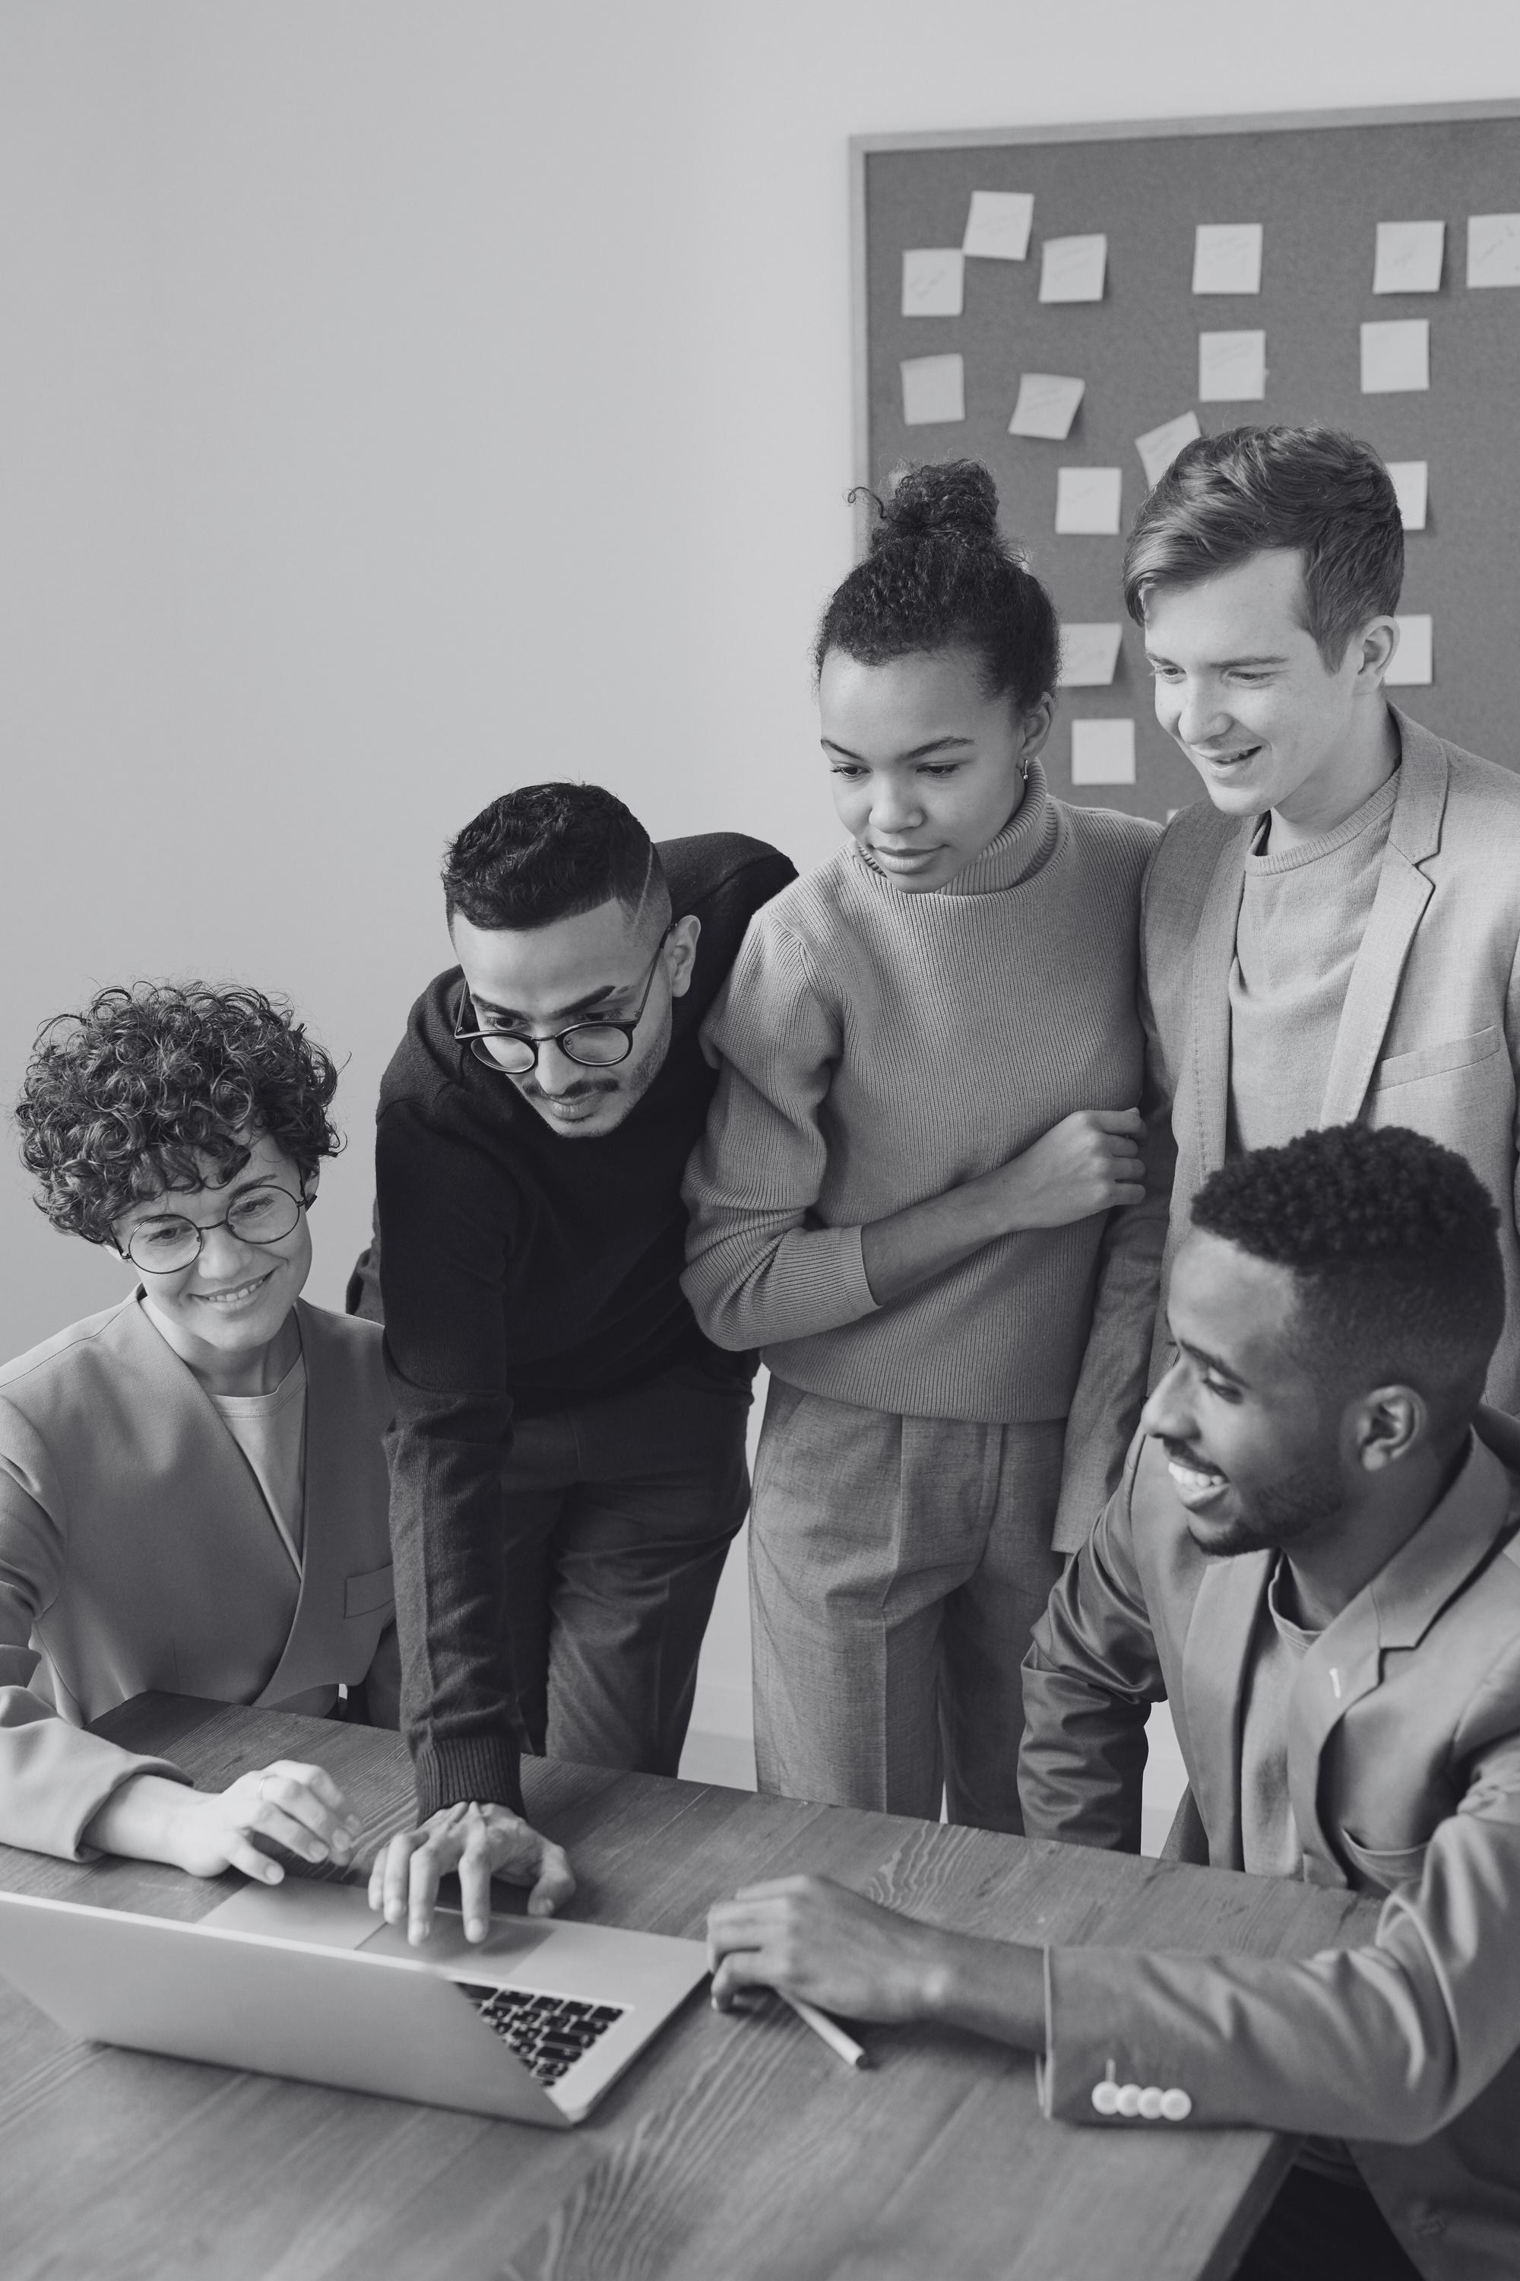

INTRODUCTION
Smart Door Lock System: An IoT-based solution for secure and remote control of home access.
Home Automation: Integrates with other smart home devices for enhanced control.
Convenience: No need for physical keys; use mobile apps, biometric authentication, or PIN codes.
Security Benefits: Provides high-level security with remote monitoring and alerts.
ESP32 Role: A versatile microcontroller that enables Wi-Fi and Bluetooth communication for smart devices.

Slide 3


Physical Key Issues:
Lost keys, key duplication, and physical wear on locks.
Limited Security:
Traditional locks can be easily bypassed or manipulated.
Unauthorized Access:
PROBLEM STATEMENT
No way to prevent or monitor unauthorized access in real-time.
Maintenance:
Traditional locks can be harder to maintain or repair in the case of malfunctions.

Slide 4



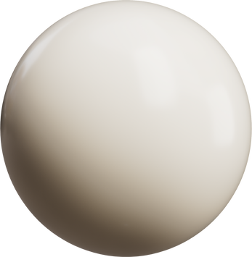
OBJECTIVES
Smart Locking Mechanism:
Ease of Use:
Security Features:
Develop a system that allows remote locking and unlocking. Provide secure access via PIN codes, biometrics, or smartphones.
Design an intuitive interface for easy control and monitoring.
Implement multiple layers of security for better protection.Enable users to check lock status and receive alerts in real-time.

Slide 5
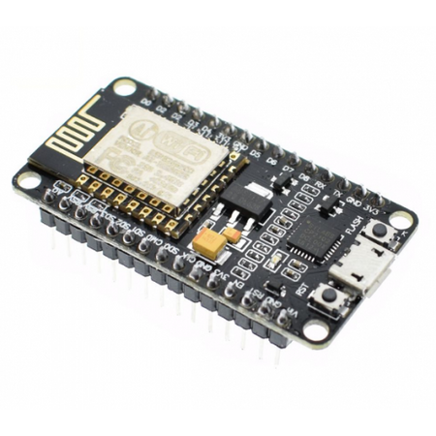
WHAT IS ESP32?
DUAL-CORE PROCESSOR:
AFFORDABLE & ACCESSIBLE:
High-performance, low-power microcontroller ideal for IoT applications. Enables communication with smartphones, cloud services, and other devices.
Cost-effective solution for DIY projects and prototypes.
VERSATILE GPIOS:
COMMUNITY SUPPORT:
Can control various components such as motors, sensors, and other peripherals.
Extensive documentation, tutorials, and libraries for easy integration and development.

Slide 6
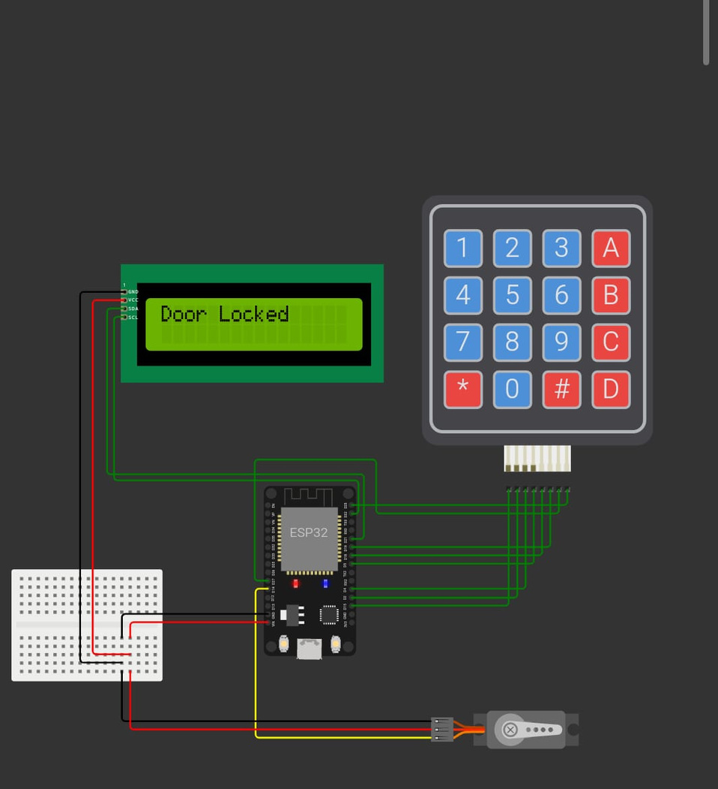
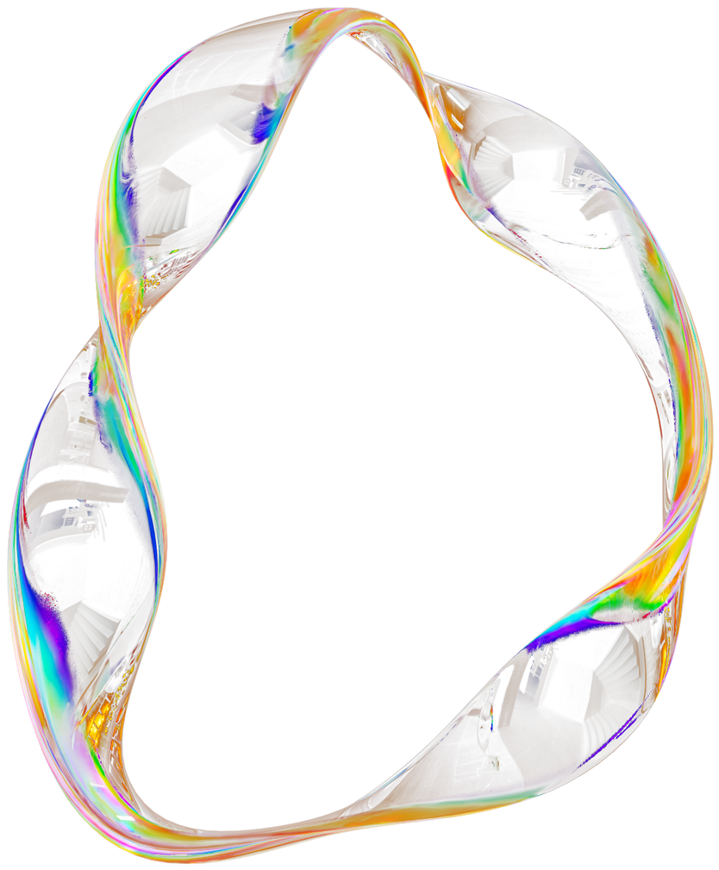
SYSTEM DESIGN
ESP32 at the Core: Acts as the central controller for processing input and triggering actions.
Lock Mechanism: Includes servo motors or solenoid locks for physical locking/unlocking.
User Input Devices: Fingerprint scanners, RFID readers, or keypads for user authentication.
Connectivity: ESP32 communicates with mobile devices or IoT platforms via Wi-Fi/Bluetooth.
Power Supply: A reliable power source, typically including a backup battery for continuous operation.

Slide 7
WORKING PRINCIPLE
SYSTEM FLOWCHART
User Authentication: The system verifies the user's identity through fingerprint, PIN, or RFID.
Signal Processing: ESP32 processes the authentication data and compares it with stored credentials.
Action Trigger: If authentication is successful, ESP32 triggers the lock mechanism to unlock the door.
Remote Control: The system allows users to lock/unlock the door remotely via a mobile app.
Notifications: Alerts are sent if there is an attempt to tamper with the lock or gain unauthorized access.
Start: User approaches the door and interacts with the system (via fingerprint, PIN, or RFID).
Input Verification: ESP32 compares the user’s input with stored credentials.
Unlock: If valid, the lock is triggered to open (servo motor or solenoid).
Remote Command: If unlocked remotely, a command is sent from the mobile app to the ESP32.
Alert System: If unauthorized access is detected, the system sends a push notification or email.

Slide 8
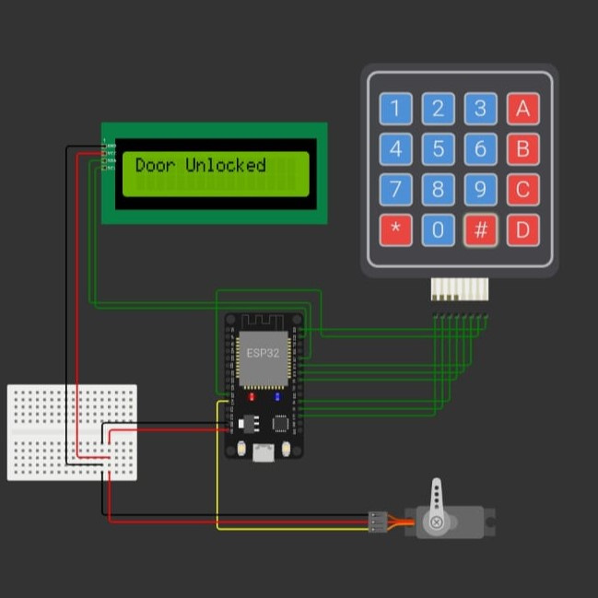
RESULT:

Slide 9
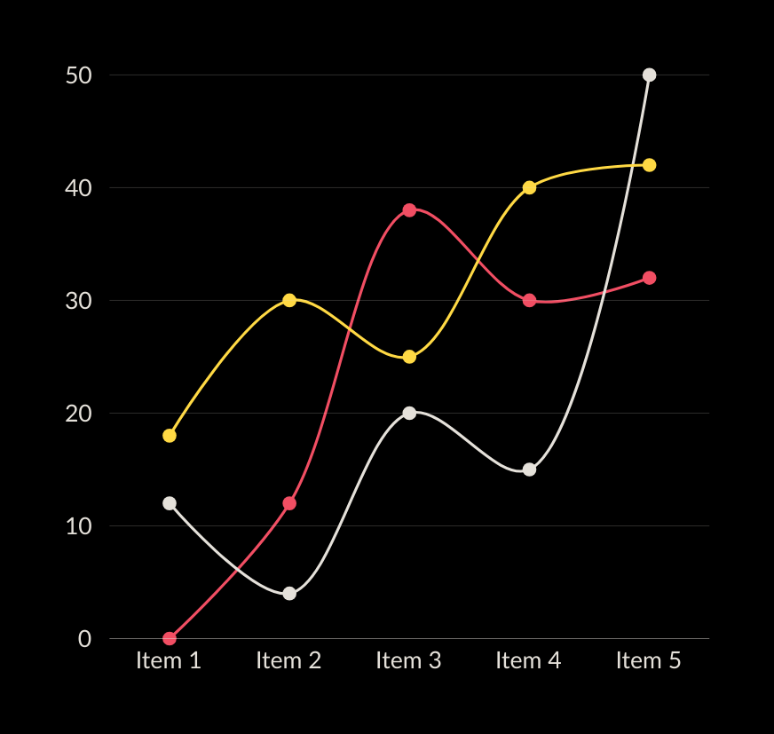
FUTURE SCOPE
Voice Integration: Adding voice control through Alexa, Google Assistant, or other virtual assistants.
Advanced Biometric Authentication: Integration with facial recognition or iris scanning for enhanced security.
AI-based Access Control: Machine learning algorithms to analyze user behavior and enhance security.
Further IoT Integration: Integrating the lock system with other home automation devices for a smarter home.

Slide 10
CONCLUSION
Innovative Security Solution:
ESP32 Efficiency:
Future Trends:
Scalability:
The ESP32 microcontroller proves to be a powerful, cost-effective solution for IoT devices.
Smart locks will continue evolving with better security features and integrations.
The system can be easily expanded to other home automation applications.
The smart door lock system provides advanced security and convenience.

Slide 11
0&1
THANK YOU
for your time and attention
Present by I Tahir Khan & Shaik Wasim

